Slide 1

DC2022MCA0044

Slide 2

Contents
Introduction
Feasibility Study
Design Diagrams
Conclusion

Slide 3


Slide 4
Introduction
Introducing Stackblend Pro, your All-In-One HR Management Solution
In today's fast-paced business environment, efficient human resource management is crucial for success. That's where Stackblend Pro comes in. Stackblend Pro is a comprehensive HR management software designed to streamline your HR processes, empowering you to focus on what truly matters – your people.
Key Features to Elevate Your HR Operations:
Effortless Shift Management: Simplify the complexities of shift scheduling, ensuring optimal staff allocation and seamless operations.
Streamlined Leave Management: Empower employees to request and track leaves with ease, while maintaining accurate records for compliance and workforce planning.
Insightful Report Generation: Gain valuable insights into your workforce data with comprehensive reports, enabling data-driven decision-making to optimize your HR strategies.
With Stackblend Pro, you'll experience enhanced efficiency, improved accuracy, and a more empowered workforce. Say goodbye to manual processes and hello to a streamlined HR experience.

Slide 5
Objective of the Project
The primary objectives of an HR management website, particularly one focusing on shift scheduling, leave management, and report generation, are to:
Streamline HR Processes: Automate and centralize core HR tasks like shift creation, leave requests, and approvals, reducing manual effort and paperwork.
Improve Workforce Management: Optimize staff allocation through efficient shift scheduling, ensuring adequate coverage and minimizing understaffing or overstaffing.
Enhance Employee Experience: Empower employees with self-service tools for leave requests, shift preferences, and access to personal information, fostering autonomy and satisfaction.
Ensure Compliance: Maintain accurate records of work hours, leave balances, and attendance, simplifying compliance with labor laws and regulations.
Data-driven decision-making: Generate insightful reports on workforce trends, attendance patterns, and leave utilization, enabling HR professionals to make informed decisions for staffing, resource allocation, and policy adjustments.

Slide 6
Objective of the Project
Cost Reduction: Minimize administrative overhead by automating routine tasks and reducing errors associated with manual data entry.
Increased Productivity: Enable HR teams to focus on strategic initiatives and employee engagement by freeing them from time-consuming administrative tasks.
Improved Communication: Facilitate transparent communication between employees and HR regarding schedules, leave, and other work-related matters.

Slide 7
Existing Systems
Spreadsheets: This is a common but inefficient method for managing shifts and leaves. It's prone to errors, lacks transparency, and is difficult to manage for large teams.
Standalone Software: Some companies might use software dedicated to specific functions like scheduling or timekeeping. These often lack integration and require manual data entry across different tools.
Paper-based System: Manual forms and physical files for leave requests and employee details can be cumbersome, inconvenient, and prone to loss.

Slide 8
Proposed Plan
To streamline workforce management and create an HR website for managing employee shifts, leaves, and statistics, the following proposed plan can be considered:
Shift Scheduling: Enable managers to create and organize employee shifts quarterly, half-yearly, annually.
Leave Management: Allow managers to manage leaves, and employees to request leaves and receive approvals from their manager.
Daily Statistics: Provide daily statistics on employee attendance and other relevant metrics.
Report Generation: The report generation module will allow for creation of reports on Shift Schedule and Leave Register. These reports will be exportable in PDF formats for easy analysis and sharing.

Slide 9


Slide 10
Technical Feasibility Study
Hardware Requirements
SL NO. | TYPE | REQUIREMENT
1. | DEVICE (HARDWARE) | COMPUTER OR LAPTOP
2. | CPU | INTEL(R) PENTIUM
4. | RAM | MIN 4GB AND MAX 16GB
5. | ROM | 32GB OR HIGHER

Slide 11
Technical Feasibility Study
Software Requirements
SL NO. | TYPE | REQUIREMENT
1. | FRONTEND | HTML5, CSS, JS, REACT, BOOTSTRAP
2. | BACKEND | NODE.JS, EXPRESS, MONGOOSE
3. | DATABASE | MONGO DB
4. | OPERATING SYSTEM | WINDOWS 11 PRO 64-BIT
5. | CODE EDITOR | VS CODE
6. | BROWSER | CHROME, MS EDGE, BRAVE
7. | VERSION CONTROL | GITHUB, GITLAB, GIT

Slide 12
Operational Feasibility
The proposed HR management website demonstrates robust operational feasibility with a user-friendly interface, and documentation for rapid onboarding, automating shift scheduling, leave management, and report generation to enhance operational efficiency; its architecture ensures seamless integration with existing systems, accessible from any desktop or laptop, empowering employees to manage schedules and request leaves conveniently; built for scalability, it will accommodate future growth, with a comprehensive assessment of resources confirming readiness and strong organizational support; a change management plan ensures smooth transition and user adoption, with potential benefits such as cost savings and enhanced employee satisfaction outweighing development and maintenance costs, ultimately transforming HR operations.

Slide 13
Economic Feasibility
The economic feasibility of the proposed HR management website is compelling, with a cost-benefit analysis indicating that while initial costs are significant, they are outweighed by long-term financial benefits and operational efficiencies; automation of HR processes like shift scheduling, leave management, and report generation will lead to significant cost savings by reducing manual effort and errors, freeing up HR staff for strategic initiatives, optimizing resource allocation, and reducing costly understaffing or overstaffing; data-driven insights will enhance workforce planning and employee performance, self-service features will boost employee satisfaction, and enhance turnover.

Slide 14


Slide 15
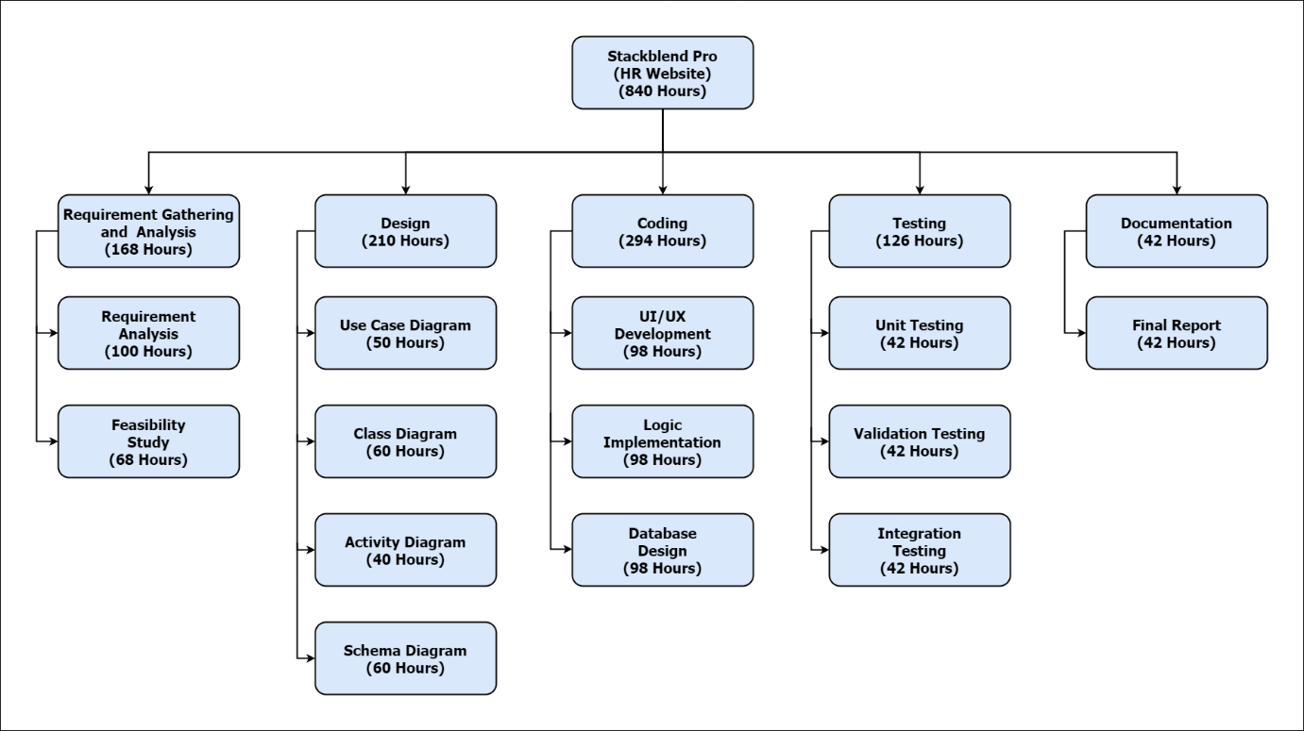
Work Breakdown Structure
Fig 1: Work Breakdown Structure

Slide 16
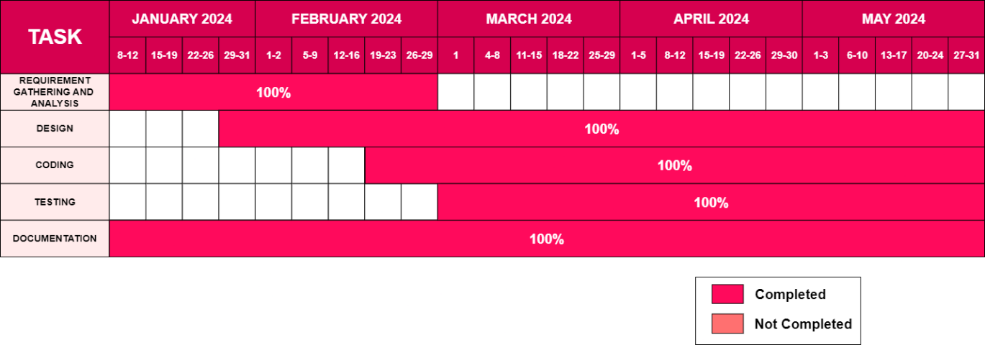
Gantt Chart
Fig 2: Gantt Chart

Slide 17


Slide 18
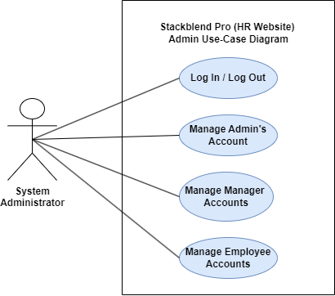
Use Case Diagrams
(Admin)
Fig 3: Use Case Diagrams

Slide 19
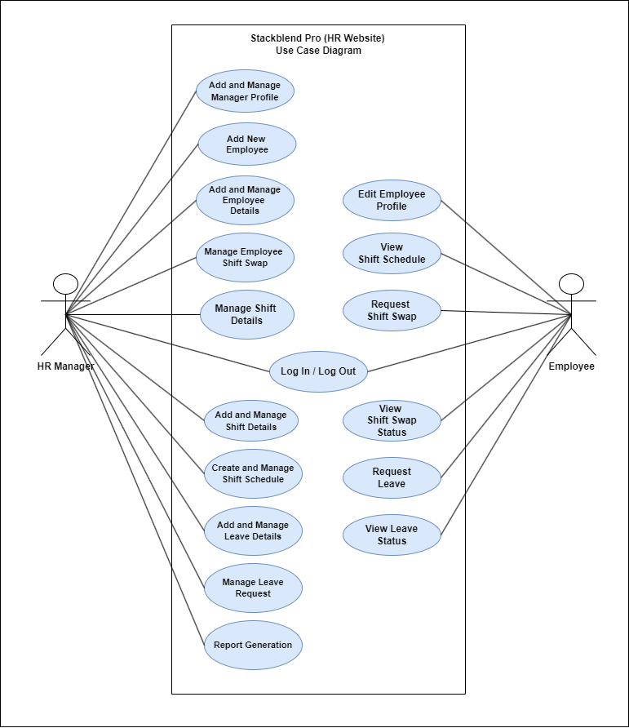
Use Case Diagrams
(User)
Fig 3: Use Case Diagrams

Slide 20
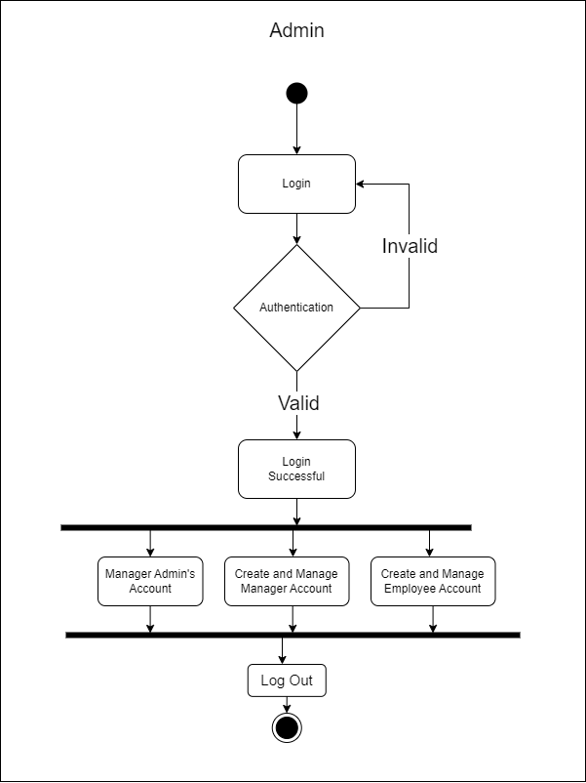
Activity Diagram
(Admin)
Fig 5: Admin Activity Diagram

Slide 21
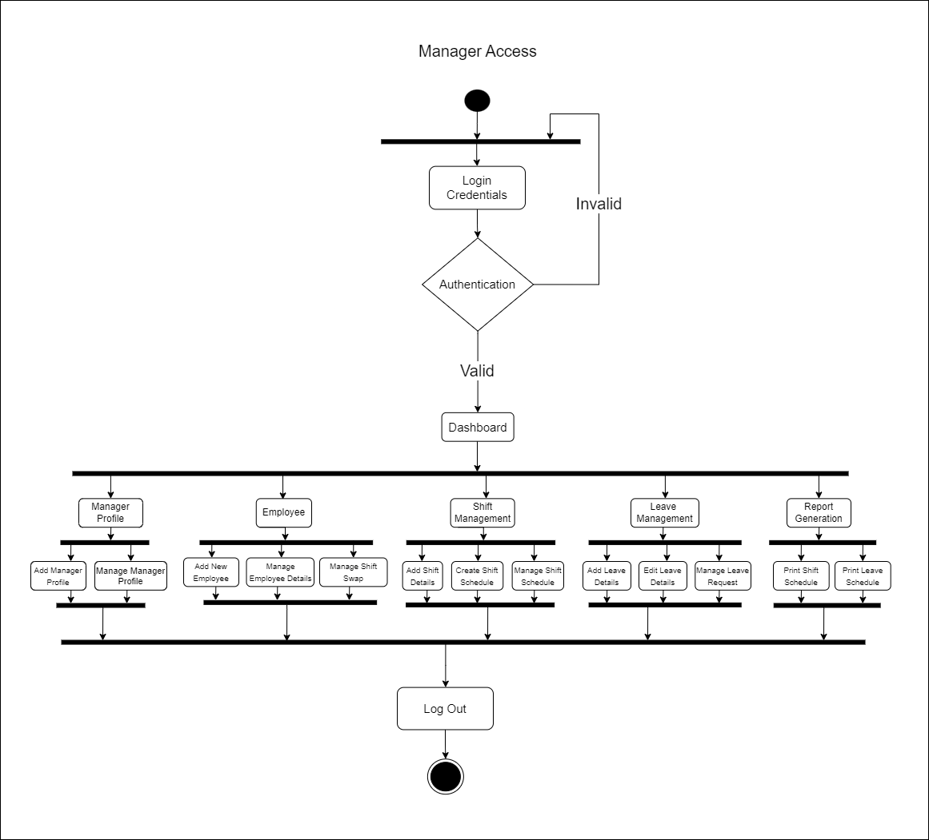
Activity Diagram
(User: Manager)
Fig 6: Manager Activity Diagram

Slide 22
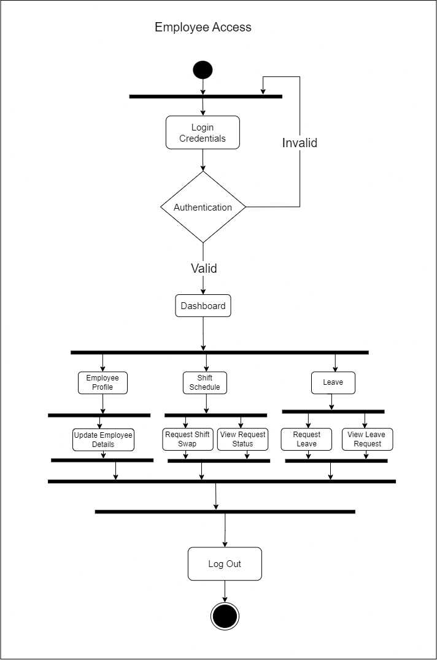
Activity Diagram
(User: Employee)
Fig 6: Employee Activity Diagram

Slide 23
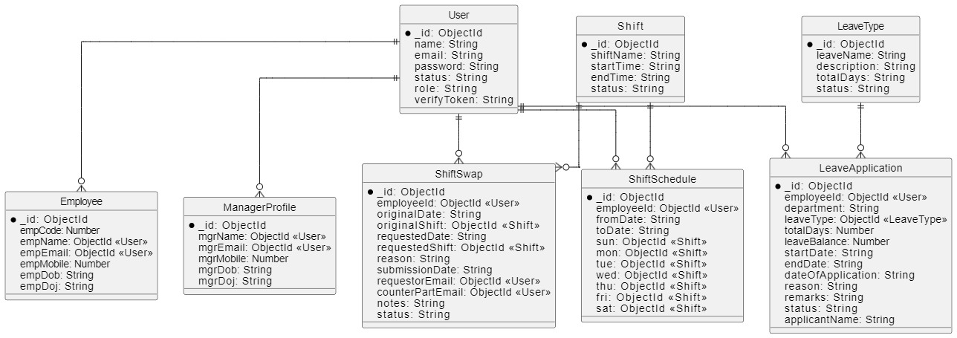
Schema Diagram
Fig 7: Schema Diagram

Slide 24


Slide 25
Conclusion
In conclusion, our HR management website, equipped with advanced shift scheduling, seamless leave management, and comprehensive report generation capabilities, serves as an indispensable tool for optimizing workforce operations, ensuring that employee schedules are efficiently managed, leave requests are handled transparently, and critical HR metrics are readily accessible for informed decision-making, ultimately fostering a more organized, productive, and harmonious workplace environment that meets the dynamic needs of modern organizations.

Slide 26


